Slide 1
A Guide to SQL, Ninth Edition
Chapter Seven
Database Administration

Slide 2
Objectives
Understand, create, and drop views
Recognize the benefits of using views
Use a view to update data
Grant and revoke users’ database privileges
Understand the purpose, advantages, and disadvantages of using an index
©2016 Cengage Learning. All Rights Reserved. May not be copied, scanned, or duplicated, in whole or in part, except for use as permitted in a license distributed with a certain product or service or otherwise on a password-protected website for classroom use.

Slide 3
Objectives (continued)
Create, use, and drop an index
Understand and obtain information from the system catalog
Use integrity constraints to control data entry
©2016 Cengage Learning. All Rights Reserved. May not be copied, scanned, or duplicated, in whole or in part, except for use as permitted in a license distributed with a certain product or service or otherwise on a password-protected website for classroom use.

Slide 4
Introduction
Database administration
  Process of managing a database
Database administrator
  Person or entire group in a business organization charged with managing the database
©2016 Cengage Learning. All Rights Reserved. May not be copied, scanned, or duplicated, in whole or in part, except for use as permitted in a license distributed with a certain product or service or otherwise on a password-protected website for classroom use.

Slide 5
Creating and Using Views
View
  A program’s or individual user’s picture of the database
Base tables
  Existing, permanent tables in a relational database
View is a derived table because data in it is retrieved from the base table
©2016 Cengage Learning. All Rights Reserved. May not be copied, scanned, or duplicated, in whole or in part, except for use as permitted in a license distributed with a certain product or service or otherwise on a password-protected website for classroom use.

Slide 6
Creating and Using Views (continued)
Usually includes less information than full database
  Simplifies data processing for the user
  Provides a measure of security by omitting sensitive information
    Unavailable to user
©2016 Cengage Learning. All Rights Reserved. May not be copied, scanned, or duplicated, in whole or in part, except for use as permitted in a license distributed with a certain product or service or otherwise on a password-protected website for classroom use.

Slide 7
Creating and Using Views (continued)
Created by a defining query
  Indicates rows and columns to include
Use CREATE VIEW command
  CREATE VIEW, followed by name of view, AS, and then defining query
©2016 Cengage Learning. All Rights Reserved. May not be copied, scanned, or duplicated, in whole or in part, except for use as permitted in a license distributed with a certain product or service or otherwise on a password-protected website for classroom use.

Slide 8
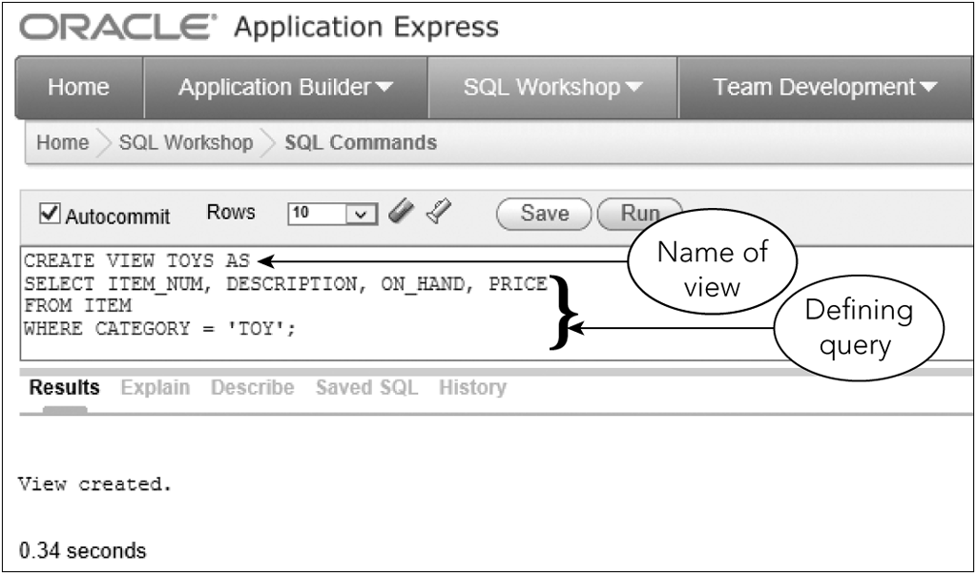
Creating and Using Views (continued)
Figure 7-1: Creating the TOYS view
©2016 Cengage Learning. All Rights Reserved. May not be copied, scanned, or duplicated, in whole or in part, except for use as permitted in a license distributed with a certain product or service or otherwise on a password-protected website for classroom use.

Slide 9
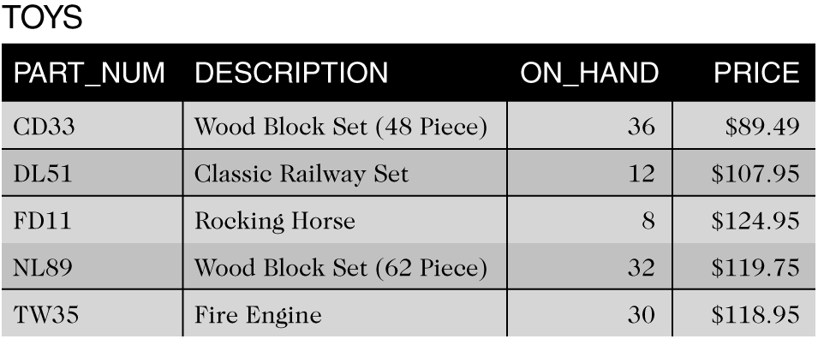
Creating and Using Views (continued)
Figure 7-2: TOYS view
©2016 Cengage Learning. All Rights Reserved. May not be copied, scanned, or duplicated, in whole or in part, except for use as permitted in a license distributed with a certain product or service or otherwise on a password-protected website for classroom use.

Slide 10
Creating and Using Views (continued)
Data shown in Figure 7-2 does not exist in this form
Not a temporary table
To query a view, merge query that created view with query to select specific data
©2016 Cengage Learning. All Rights Reserved. May not be copied, scanned, or duplicated, in whole or in part, except for use as permitted in a license distributed with a certain product or service or otherwise on a password-protected website for classroom use.

Slide 11
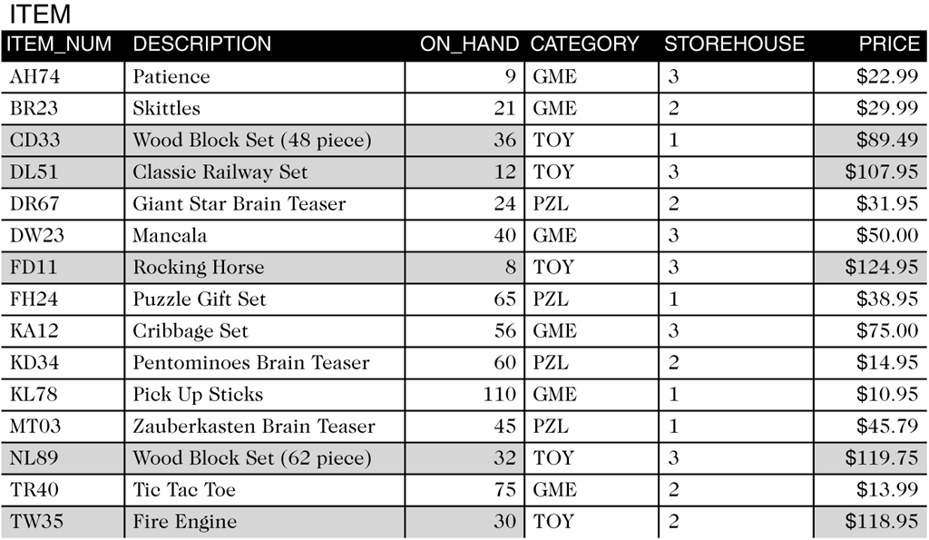
Creating and Using Views (continued)
Figure 7-3: Maria’s view of the ITEM table
©2016 Cengage Learning. All Rights Reserved. May not be copied, scanned, or duplicated, in whole or in part, except for use as permitted in a license distributed with a certain product or service or otherwise on a password-protected website for classroom use.

Slide 12
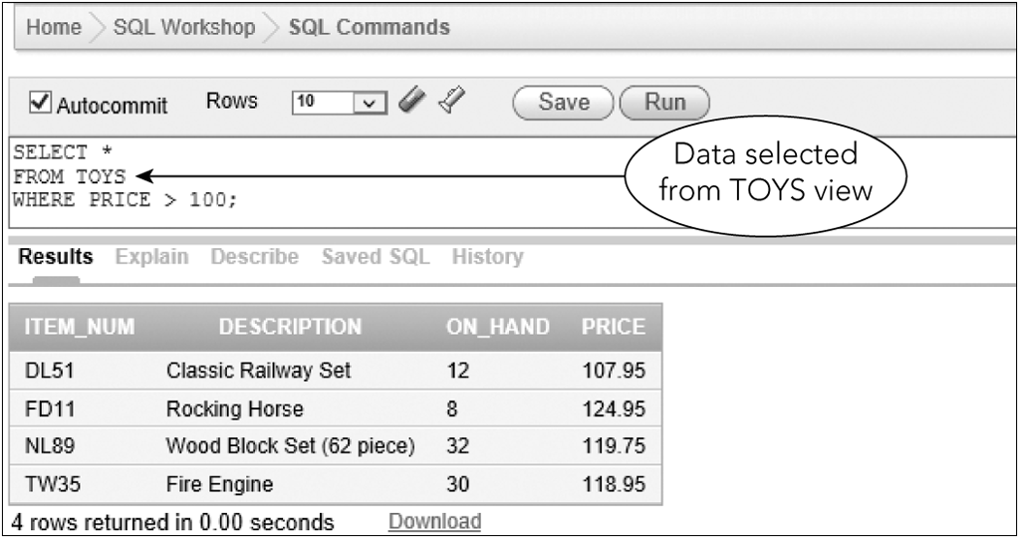
Creating and Using Views (continued)
Figure 7-4: Using the TOYS view
©2016 Cengage Learning. All Rights Reserved. May not be copied, scanned, or duplicated, in whole or in part, except for use as permitted in a license distributed with a certain product or service or otherwise on a password-protected website for classroom use.

Slide 13
Creating and Using Views (continued)
Actual query executed by SQL
SELECT ITEM_NUM, DESCRIPTION, ON_HAND, PRICE
FROM ITEM
WHERE CATEGORY =‘TOY’
AND PRICE > 100;
©2016 Cengage Learning. All Rights Reserved. May not be copied, scanned, or duplicated, in whole or in part, except for use as permitted in a license distributed with a certain product or service or otherwise on a password-protected website for classroom use.

Slide 14
Creating and Using Views (continued)
Can assign column names in view that are different than base table
Include new column names in parentheses, following the name of the view
Output will display new column names
©2016 Cengage Learning. All Rights Reserved. May not be copied, scanned, or duplicated, in whole or in part, except for use as permitted in a license distributed with a certain product or service or otherwise on a password-protected website for classroom use.

Slide 15
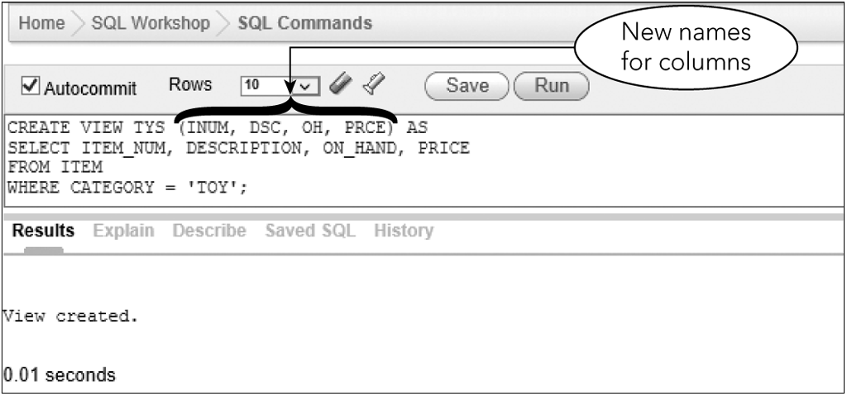
Creating and Using Views (continued)
Figure 7-5: Renaming columns when creating a view
©2016 Cengage Learning. All Rights Reserved. May not be copied, scanned, or duplicated, in whole or in part, except for use as permitted in a license distributed with a certain product or service or otherwise on a password-protected website for classroom use.

Slide 16
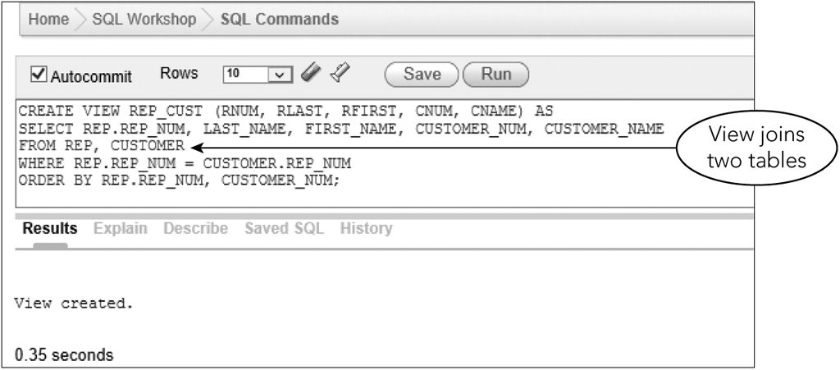
Creating and Using Views (continued)
Defining query of view can be any valid SQL query
View can join two or more tables
Figure 7-7: Creating the REP_CUST view
©2016 Cengage Learning. All Rights Reserved. May not be copied, scanned, or duplicated, in whole or in part, except for use as permitted in a license distributed with a certain product or service or otherwise on a password-protected website for classroom use.

Slide 17
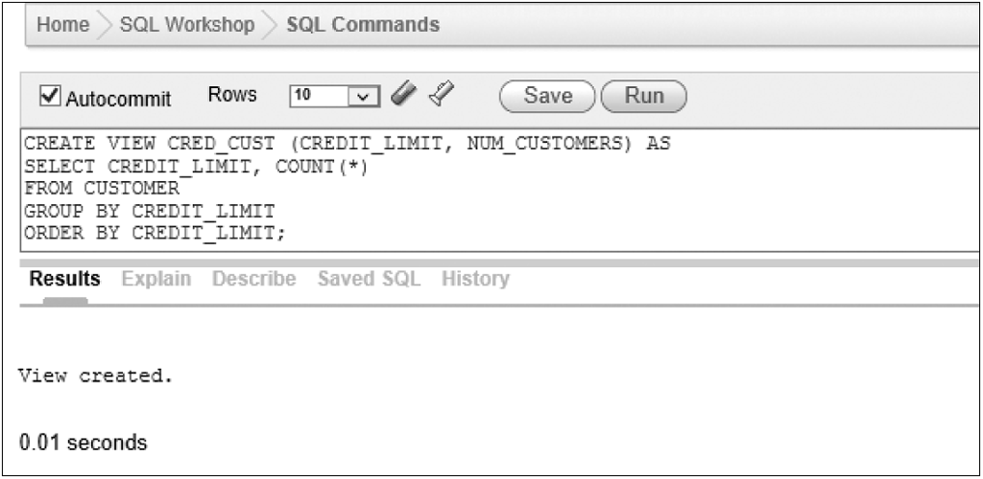
Creating and Using Views (continued)
A view can involve statistics
Figure 7-9: Creating the CRED_CUST view
©2016 Cengage Learning. All Rights Reserved. May not be copied, scanned, or duplicated, in whole or in part, except for use as permitted in a license distributed with a certain product or service or otherwise on a password-protected website for classroom use.

Slide 18
Creating and Using Views (continued)
Benefits of views
  Provide data independence
    Can often be used even after database structure changes
  Different users can view same data differently
    Customize display to meet each user’s needs
  A view can contain only those columns required by a given user
    Simplifies user’s perception of database
    Provides a measure of security
©2016 Cengage Learning. All Rights Reserved. May not be copied, scanned, or duplicated, in whole or in part, except for use as permitted in a license distributed with a certain product or service or otherwise on a password-protected website for classroom use.

Slide 19
Using a View to Update Data
Benefits of views are for retrieval purposes only
Updating data through a view is dependent on type of view
©2016 Cengage Learning. All Rights Reserved. May not be copied, scanned, or duplicated, in whole or in part, except for use as permitted in a license distributed with a certain product or service or otherwise on a password-protected website for classroom use.

Slide 20
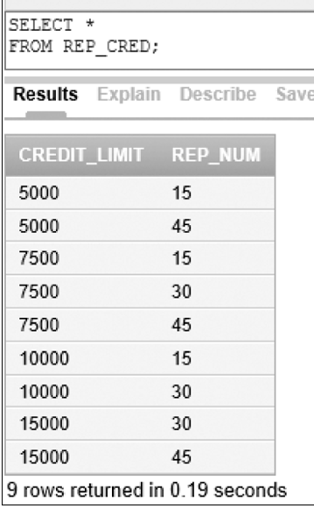
Updating Row-and-Column Subset Views
Can update (usually) if view contains primary key
Cannot update when primary key is not included
No primary key
©2016 Cengage Learning. All Rights Reserved. May not be copied, scanned, or duplicated, in whole or in part, except for use as permitted in a license distributed with a certain product or service or otherwise on a password-protected website for classroom use.

Slide 21
Updating Views Involving Joins
Can update when a view is derived by joining two tables on primary key of each table
Cannot update when view involves joining by matching the primary key of one table with a column that is not the primary key
Encounter more severe problems if neither of the join columns is a primary key
©2016 Cengage Learning. All Rights Reserved. May not be copied, scanned, or duplicated, in whole or in part, except for use as permitted in a license distributed with a certain product or service or otherwise on a password-protected website for classroom use.

Slide 22
Updating Views Involving Statistics
Most difficult to update
Cannot add rows to a view that includes calculations
©2016 Cengage Learning. All Rights Reserved. May not be copied, scanned, or duplicated, in whole or in part, except for use as permitted in a license distributed with a certain product or service or otherwise on a password-protected website for classroom use.

Slide 23
Dropping a View
Remove a view that is no longer needed with DROP VIEW command
The DROP VIEW command removes only the view definition
  Base table and data remain unchanged
©2016 Cengage Learning. All Rights Reserved. May not be copied, scanned, or duplicated, in whole or in part, except for use as permitted in a license distributed with a certain product or service or otherwise on a password-protected website for classroom use.

Slide 24
Security
Prevention of unauthorized access to a database
  Some users may be able to retrieve and update anything in database
  Other users may be able to retrieve data but not change data
  Other users may be able to access only a portion of data
©2016 Cengage Learning. All Rights Reserved. May not be copied, scanned, or duplicated, in whole or in part, except for use as permitted in a license distributed with a certain product or service or otherwise on a password-protected website for classroom use.

Slide 25
Security (continued)
GRANT command
  Main mechanism for providing access to database
Database administrator can grant different types of privileges to users and revoke them later
Privileges include rights to select, insert, update, index, and delete table data
©2016 Cengage Learning. All Rights Reserved. May not be copied, scanned, or duplicated, in whole or in part, except for use as permitted in a license distributed with a certain product or service or otherwise on a password-protected website for classroom use.

Slide 26
Security (continued)
Database administrator uses REVOKE command to remove privileges from users
Format is similar to GRANT command
©2016 Cengage Learning. All Rights Reserved. May not be copied, scanned, or duplicated, in whole or in part, except for use as permitted in a license distributed with a certain product or service or otherwise on a password-protected website for classroom use.

Slide 27
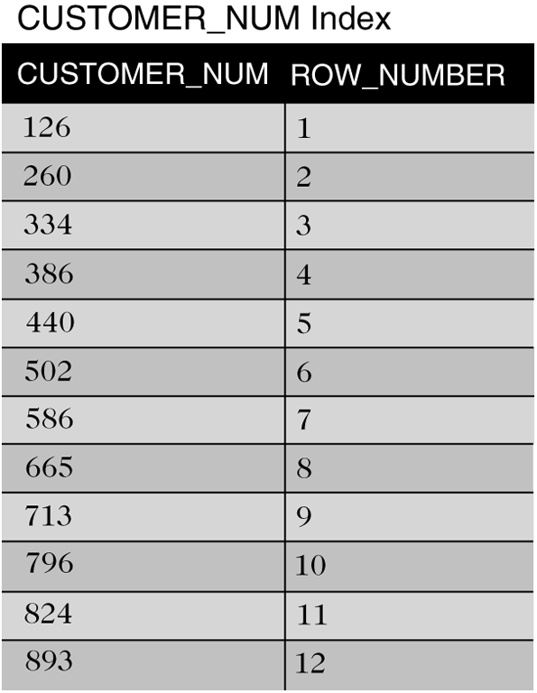
Indexes
Speeds up the searching of tables
Similar to an index in a book
Figure 7-19: Index for the CUSTOMER table on the CUSTOMER_NUM column
©2016 Cengage Learning. All Rights Reserved. May not be copied, scanned, or duplicated, in whole or in part, except for use as permitted in a license distributed with a certain product or service or otherwise on a password-protected website for classroom use.

Slide 28
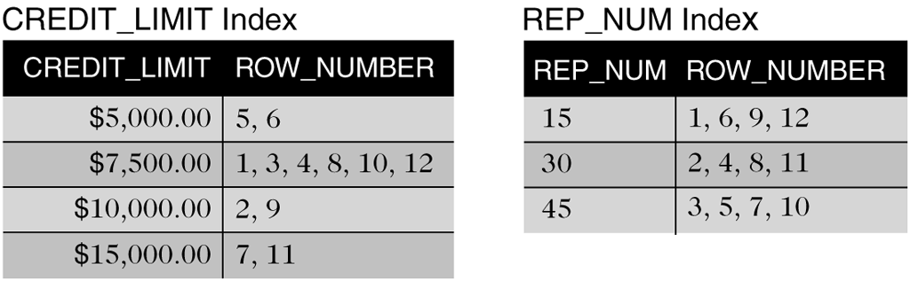
Indexes (continued)
Figure 7-20: Indexes for the CUSTOMER table on the CREDIT_LIMIT and REP_NUM columns
©2016 Cengage Learning. All Rights Reserved. May not be copied, scanned, or duplicated, in whole or in part, except for use as permitted in a license distributed with a certain product or service or otherwise on a password-protected website for classroom use.

Slide 29
Indexes (continued)
SQL manages indexes
User determines columns on which to build indexes
Disadvantages
  Index occupies disk space
  DBMS must update index as data is entered
©2016 Cengage Learning. All Rights Reserved. May not be copied, scanned, or duplicated, in whole or in part, except for use as permitted in a license distributed with a certain product or service or otherwise on a password-protected website for classroom use.

Slide 30
Creating an Index
Use CREATE INDEX command
  Name the index
  Identify the table
  Identify the column or columns
©2016 Cengage Learning. All Rights Reserved. May not be copied, scanned, or duplicated, in whole or in part, except for use as permitted in a license distributed with a certain product or service or otherwise on a password-protected website for classroom use.

Slide 31
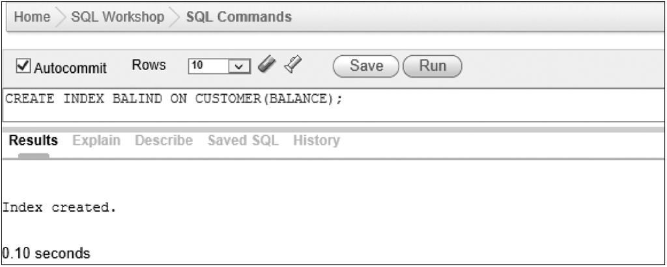
Creating an Index (continued)
Index on a single column
Figure 7-21: Creating the BALIND index on the BALANCE column
©2016 Cengage Learning. All Rights Reserved. May not be copied, scanned, or duplicated, in whole or in part, except for use as permitted in a license distributed with a certain product or service or otherwise on a password-protected website for classroom use.

Slide 32
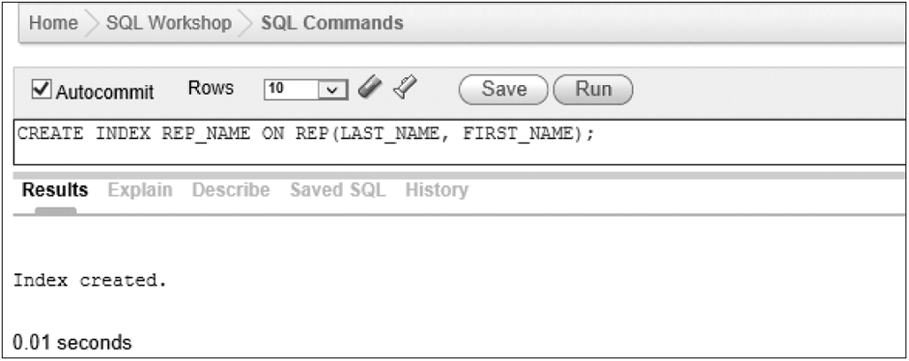
Creating an Index (continued)
Index on two columns
Figure 7-22: Creating the REP_NAME index on the LAST_NAME and FIRST_NAME columns
©2016 Cengage Learning. All Rights Reserved. May not be copied, scanned, or duplicated, in whole or in part, except for use as permitted in a license distributed with a certain product or service or otherwise on a password-protected website for classroom use.

Slide 33
Dropping an Index
Use DROP INDEX to delete an index
  DROP INDEX followed by name of index to drop
Permanently deletes index
©2016 Cengage Learning. All Rights Reserved. May not be copied, scanned, or duplicated, in whole or in part, except for use as permitted in a license distributed with a certain product or service or otherwise on a password-protected website for classroom use.

Slide 34
Creating Unique Indexes
To ensure uniqueness of non-primary key data, you can create a unique index
  Use CREATE UNIQUE INDEX command
A unique index will reject any update that would cause a duplicate value in the specified column
©2016 Cengage Learning. All Rights Reserved. May not be copied, scanned, or duplicated, in whole or in part, except for use as permitted in a license distributed with a certain product or service or otherwise on a password-protected website for classroom use.

Slide 35
System Catalog
Contains information about tables in database; also called data dictionary
Use SYSTABLES to list all tables in database
Use SYSCOLUMNS to list all columns in a table
Use SYSVIEWS to list information about views
©2016 Cengage Learning. All Rights Reserved. May not be copied, scanned, or duplicated, in whole or in part, except for use as permitted in a license distributed with a certain product or service or otherwise on a password-protected website for classroom use.

Slide 36
System Catalog (continued)
In Oracle, use:
  DBA_TABLES to list information about tables
  DBA_TAB_COLUMNS to list information about columns
  DBA_VIEWS to list information about views
©2016 Cengage Learning. All Rights Reserved. May not be copied, scanned, or duplicated, in whole or in part, except for use as permitted in a license distributed with a certain product or service or otherwise on a password-protected website for classroom use.

Slide 37
Update of the System Catalog
DBMS updates automatically when
  Create, alter, drop tables
  Create or drop indexes
Users should not update catalog directly
©2016 Cengage Learning. All Rights Reserved. May not be copied, scanned, or duplicated, in whole or in part, except for use as permitted in a license distributed with a certain product or service or otherwise on a password-protected website for classroom use.

Slide 38
Integrity Constraints in SQL
Rule for the data in the database
  Examples in TAL Distributors
    A sales rep’s number must be unique
    The sales rep number for a customer must match an exiting sales rep number
    Categories for items must be GME, TOY, or PZL
©2016 Cengage Learning. All Rights Reserved. May not be copied, scanned, or duplicated, in whole or in part, except for use as permitted in a license distributed with a certain product or service or otherwise on a password-protected website for classroom use.

Slide 39
Integrity Constraints in SQL (continued)
Integrity support is process of specifying integrity constraints for the database
Clauses to support integrity constraints can be specified within a CREATE TABLE or
ALTER TABLE command
  ADD PRIMARY KEY
  ADD FOREIGN KEY
©2016 Cengage Learning. All Rights Reserved. May not be copied, scanned, or duplicated, in whole or in part, except for use as permitted in a license distributed with a certain product or service or otherwise on a password-protected website for classroom use.

Slide 40
Integrity Constraints in SQL (continued)
Primary keys
  Use ADD PRIMARY KEY clause on ALTER TABLE command to add after creating a table
Foreign keys
  A column in one table whose value matches the primary key in another
Legal values
  The CHECK clause ensures only legal values are allowed in a given column
©2016 Cengage Learning. All Rights Reserved. May not be copied, scanned, or duplicated, in whole or in part, except for use as permitted in a license distributed with a certain product or service or otherwise on a password-protected website for classroom use.

Slide 41
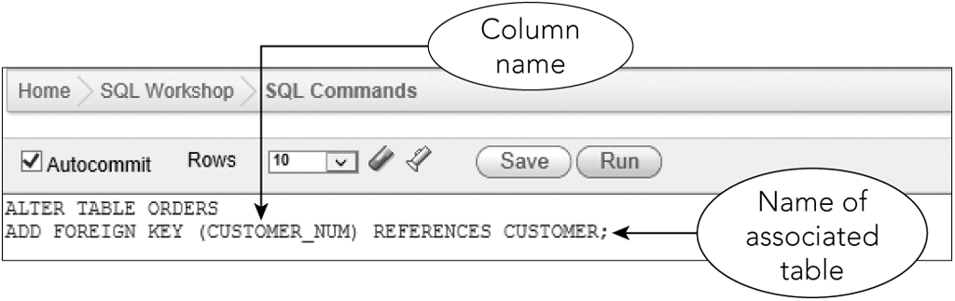
Integrity Constraints in SQL (continued)
Figure 7-24: Adding a foreign key to an existing table
©2016 Cengage Learning. All Rights Reserved. May not be copied, scanned, or duplicated, in whole or in part, except for use as permitted in a license distributed with a certain product or service or otherwise on a password-protected website for classroom use.

Slide 42
Integrity Constraints in SQL (continued)
After creating a foreign key, DBMS rejects any update that violates the foreign key constraint
  Error messages refer to parent and child
  When specifying a foreign key, table containing foreign key is the child
  Table referenced by foreign key is parent
©2016 Cengage Learning. All Rights Reserved. May not be copied, scanned, or duplicated, in whole or in part, except for use as permitted in a license distributed with a certain product or service or otherwise on a password-protected website for classroom use.

Slide 43
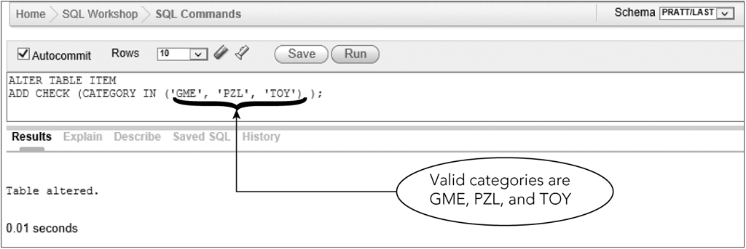
Integrity Constraints in SQL (continued)
Figure 7-27: Adding an integrity constraint to an existing table
©2016 Cengage Learning. All Rights Reserved. May not be copied, scanned, or duplicated, in whole or in part, except for use as permitted in a license distributed with a certain product or service or otherwise on a password-protected website for classroom use.

Slide 44
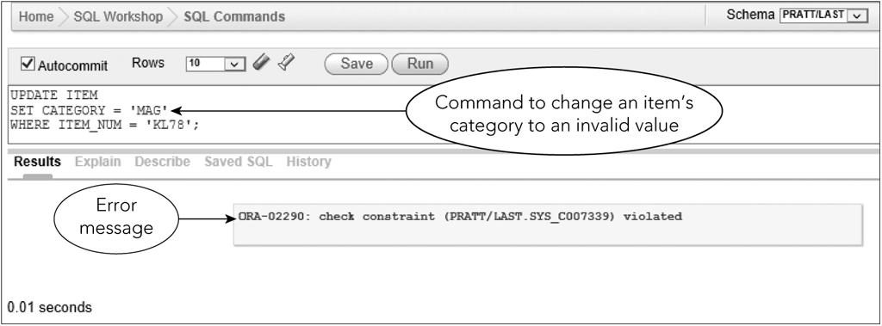
Integrity Constraints in SQL
(continued)
Figure 7-28: Update that violates the integrity constraint
©2016 Cengage Learning. All Rights Reserved. May not be copied, scanned, or duplicated, in whole or in part, except for use as permitted in a license distributed with a certain product or service or otherwise on a password-protected website for classroom use.

Slide 45
Summary
Views
  CREATE VIEW command
  Benefits
  Update issues
  DROP VIEW command
Security features
  GRANT
  REVOKE
©2016 Cengage Learning. All Rights Reserved. May not be copied, scanned, or duplicated, in whole or in part, except for use as permitted in a license distributed with a certain product or service or otherwise on a password-protected website for classroom use.

Slide 46
Summary (continued)
Indexes
  Make data retrieval more efficient
  CREATE INDEX
  DROP INDEX
System catalog information
  SYSTABLES, SYSCOLUMNS, SYSVIEWS
  DBA_TABLES, DBA_TAB_COLUMNS, DBA_VIEWS
©2016 Cengage Learning. All Rights Reserved. May not be copied, scanned, or duplicated, in whole or in part, except for use as permitted in a license distributed with a certain product or service or otherwise on a password-protected website for classroom use.

Slide 47
Summary (continued)
Integrity constraints
  ADD PRIMARY KEY
  ADD FOREIGN KEY
  CHECK
©2016 Cengage Learning. All Rights Reserved. May not be copied, scanned, or duplicated, in whole or in part, except for use as permitted in a license distributed with a certain product or service or otherwise on a password-protected website for classroom use.

